Slide 1


Work System Design Project
(IM29202)
~Group 4

Slide 2
Defence and security
Traffic Police Work System
Sanskar Agrawal 20IM30019
Sneha Kumari 20IM30020
Sridhara Manideep 20IM30021
Suvigya Saxena 20IM30022
Vedant Tarole 20IM30023
Trisha Sarwade 20IM30024
Udit Jain 20IM30025
Sanil Upasani 20IM30026

Slide 3
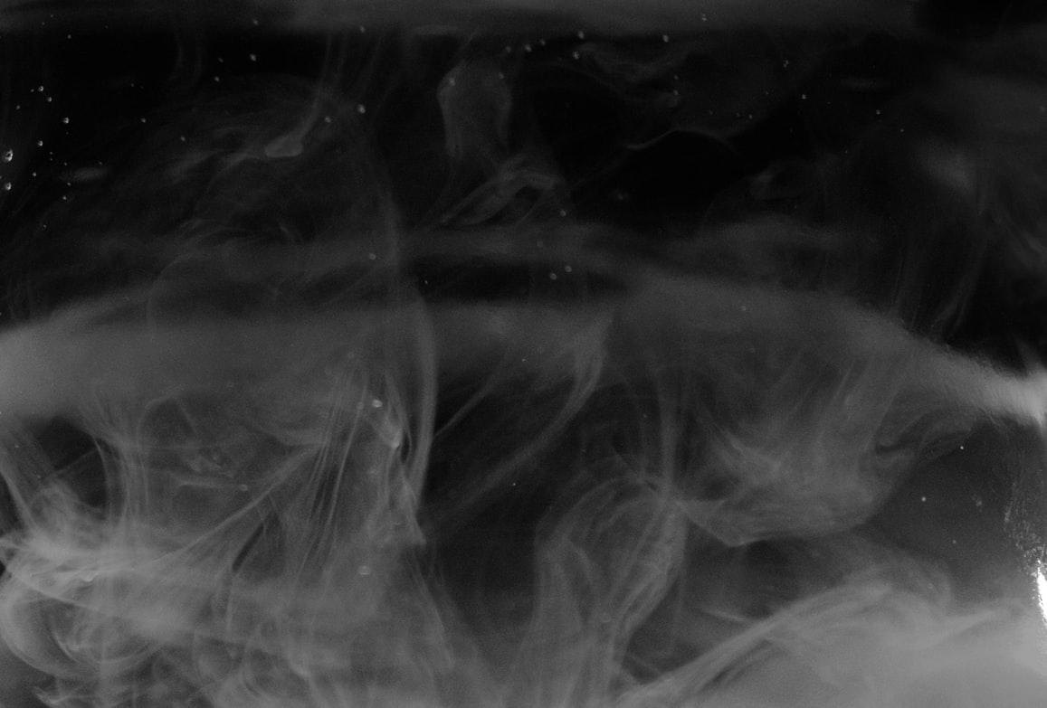
Did you know?
23% of Traffic police officers are reported to be hypertensive, 12.2% have respiratory problems, 18.7% are associated with skin problems, 50.4% complain of low back pain, 24.5% report eye problems, 14.4% have low PEFR, and 12.9% are found to have varicose veins by Trendelenberg’s test. Significant association (p<0.05) has been found between years of service with diabetes, hypertension, abnormal waist circumference and usage of personal protective equipment (mask and sunglasses).

Slide 4

They are there for us during weekdays and weekends, sun and rain. They are so exposed to the harsh weather.Be it 45deg. or 15deg, Day in and out they work hard for our safety and wellbeing on roads. Festivals and holidays, neither of these affect them

Slide 5
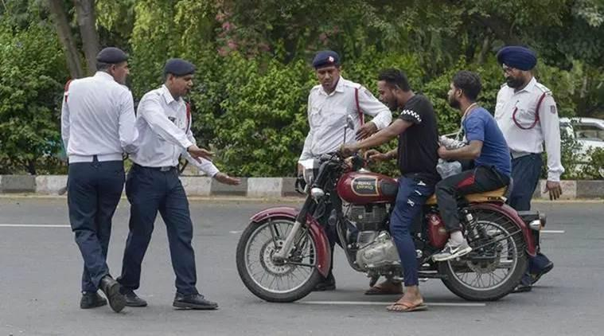
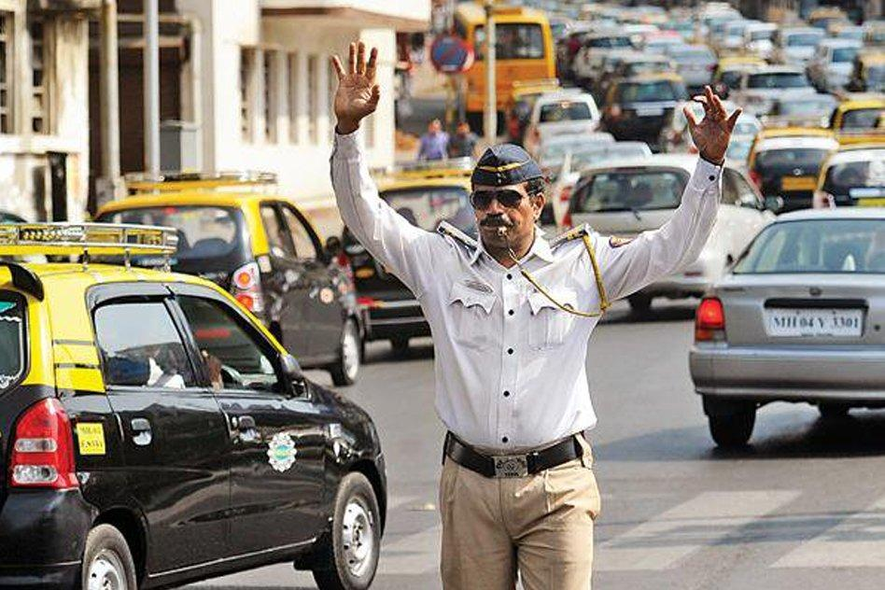
Think about this!
We always find one crossing being handled by 4-5 traffic policemen and the next one with none. People cite that there are too few traffic policemen for the number of vehicles on the road.
What if there is an even distribution with systematic handling?

Slide 6
The above mentioned aspects made us rethink on the current management process of the traffic police.
Hence we are redesigning the complete traffic control system taking the ergonomic and uneven distributive factors into consideration. This will resolve the major issues of traffic control system.

Slide 7
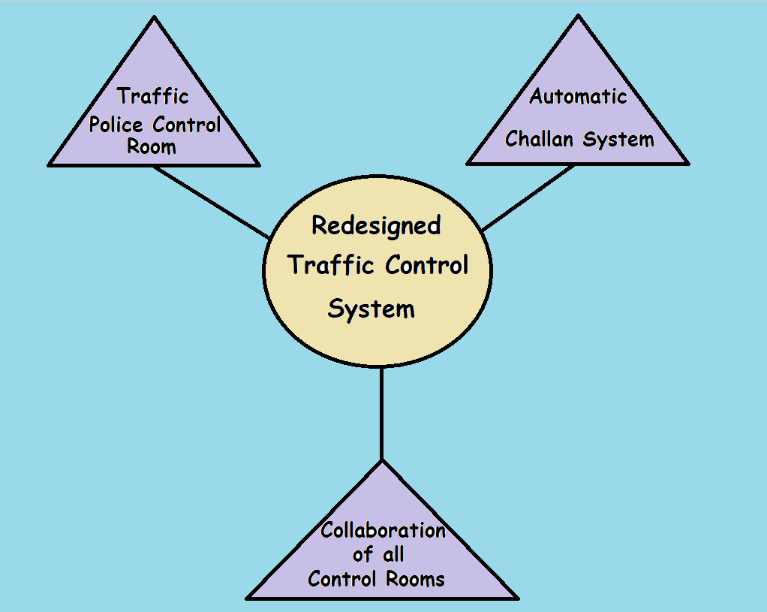
Our Model

Slide 8
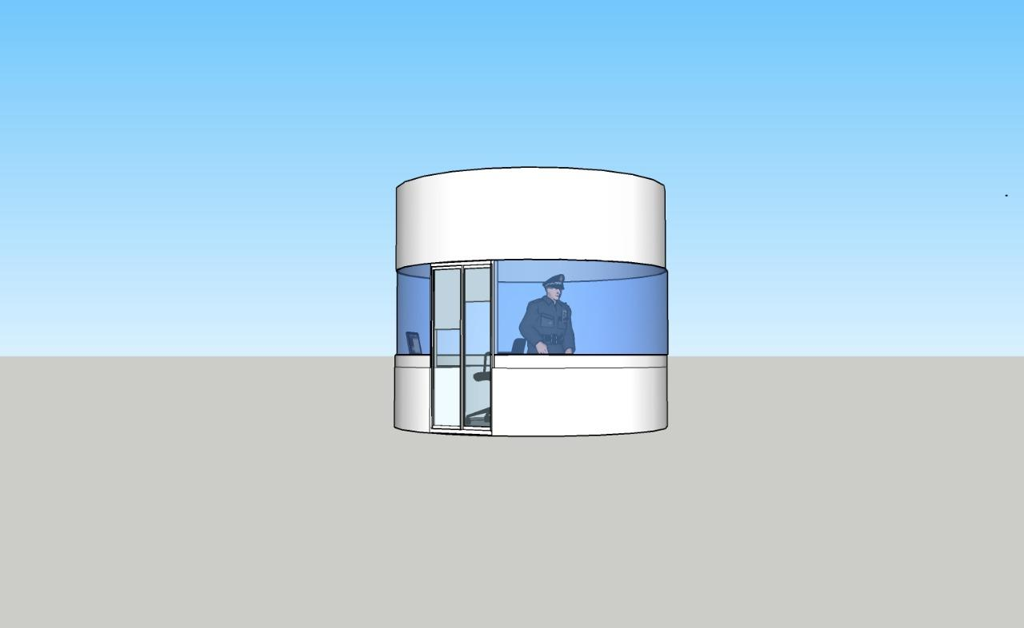
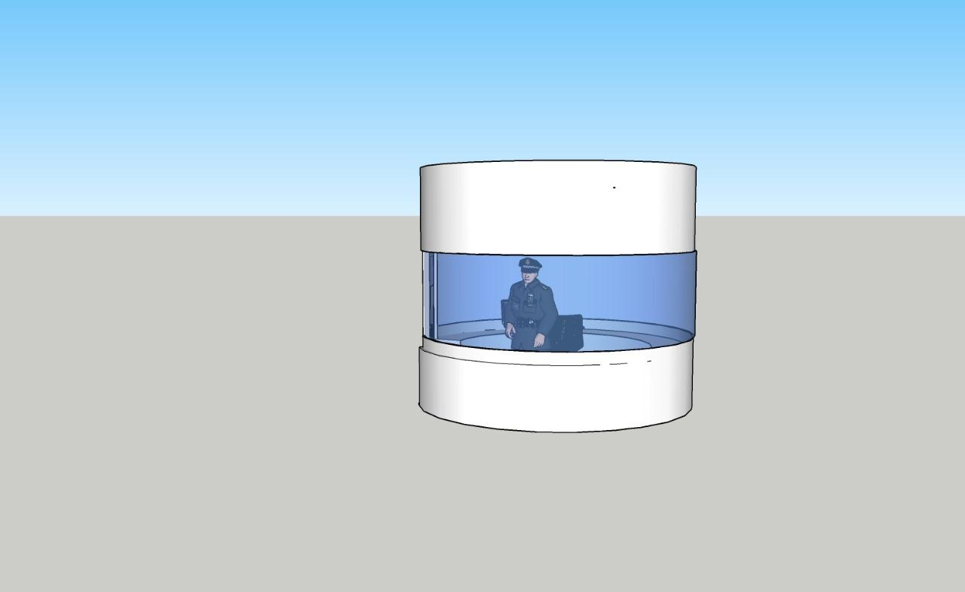
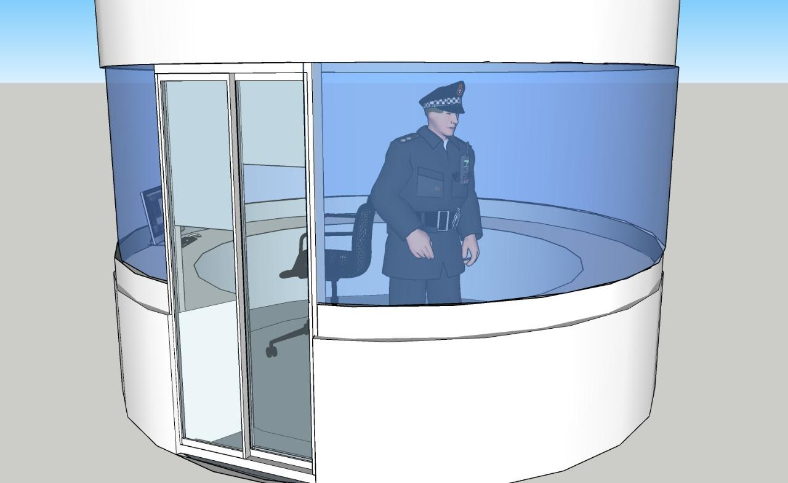
Traffic Police Control Room

Slide 9
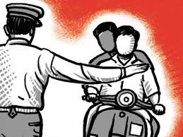
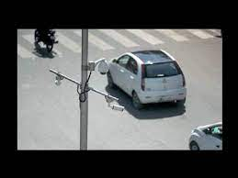
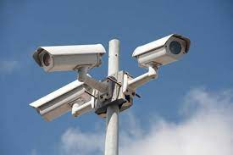
Automatic Challan System

Slide 10

E-Challans
Traffic official enters vehicle number in the App
Input video from surveillance camera
Vehicle Owner’s information retrieved from RTO database
Object detection (4-wheeler)
Traffic official selects the traffic rules violated
Identification of vehicles entering ROI
Corresponding entry made in defaulter database
License plate number detection using OpenALPR
Detect plate with highest accuracy
e-Challan sent through SMS and eMail
Check in database
Vehicle number entered in defaulter database

Slide 11

Collaboration of the Control Rooms

Slide 12






When required, Special Traffic Arrangements can be made for smooth movement of VIP and emergency Vehicles.
The control room is designed to be of a cylindrical shape, will be constructed with laminated glass with the help of 3D printers and will consist of an ergonomic chair
6
1
Communication between the control rooms to allow quick and faster implementation of internal plans.
It will function to measure vehicle density and accordingly manage the traffic. The data collected by cameras will also help in future in various situations.
5
2
4
Automatic Challan system integrated with an email system that generates bills and re-directs it to the owner of the vehicle.
3
High performance cameras will be able to detect faces of drivers and collect the respective data.

Slide 13





Health and Ailments
Major Ailments
Statistics
68% complain of frequent coughing, 22% report having shortness of breath and 36% suffer from irritation in respiratory tract, according to a study conducted in Bengaluru.
Various respiratory diseases like asthma and bronchitis. Prolonged exposure to pollution can also lead to lung cancer.
Ailments
Govt. schemes
Eye irritation, Chronic Cough, Wheeze, Dermatitis, Anxiety, Varicose veins, Fatigue and low chest expansion
There are various state govt. Schemes but they are not very efficient and have many loopholes.

Slide 14



Analysis on expenditure
The traffic policemen suffer some chronic illnesses demolishing their health.
Prolonged exposure to pollution may even lead to lung cancer and its cost for treatment is beyond a figure to mention in a presentation.
Bronchial Asthma
(Rs.4000)
Anxiety
(Rs.2000-3000)
Approximate cost per unit:
Rs. 2,50,000
Chronic Cough
(Rs.1000-2000)

Slide 15
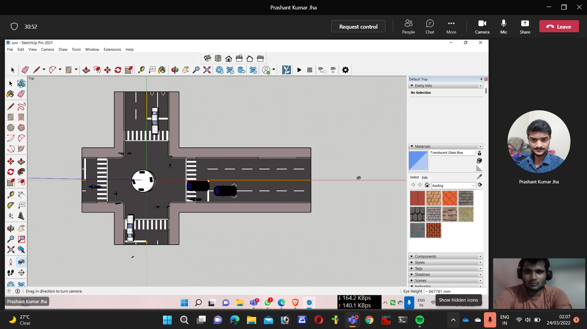
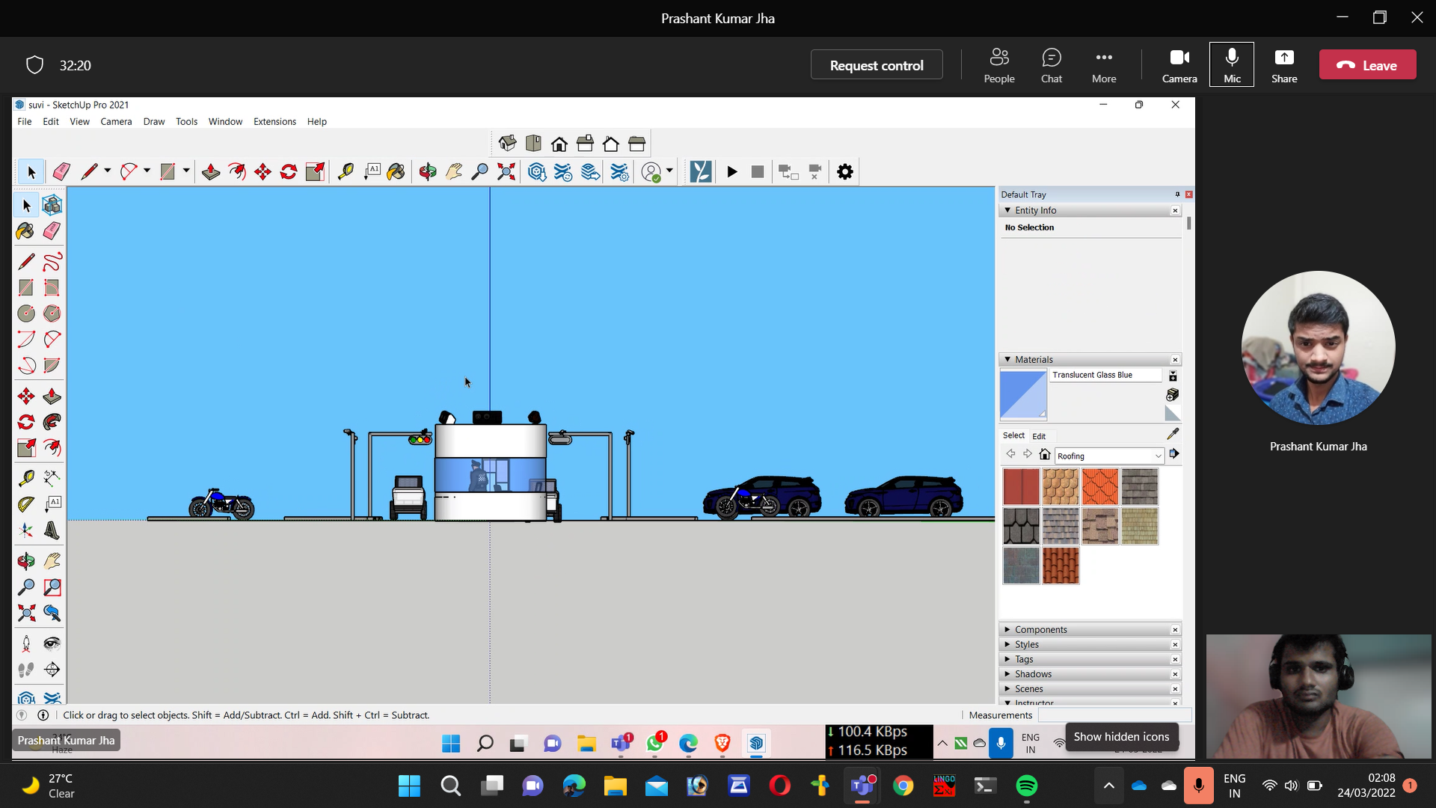
TOP VIEW
SIDE VIEW

Slide 16
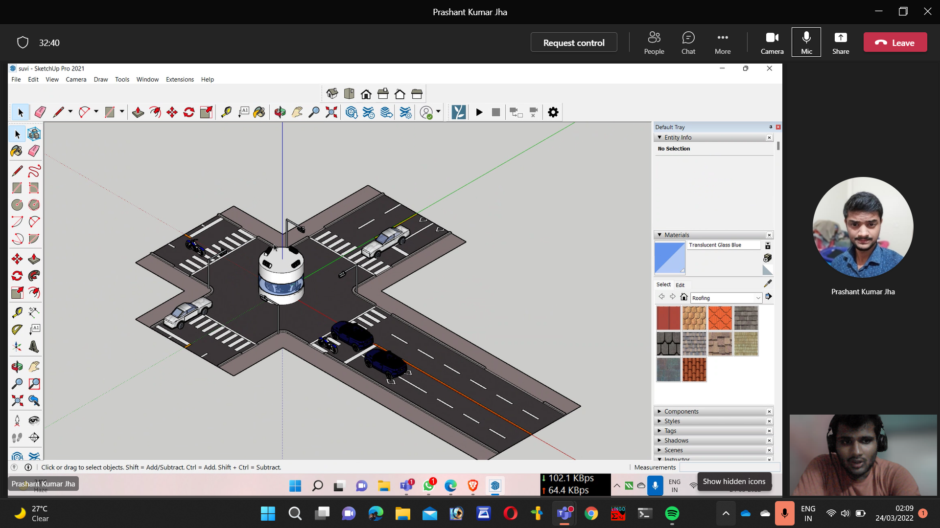
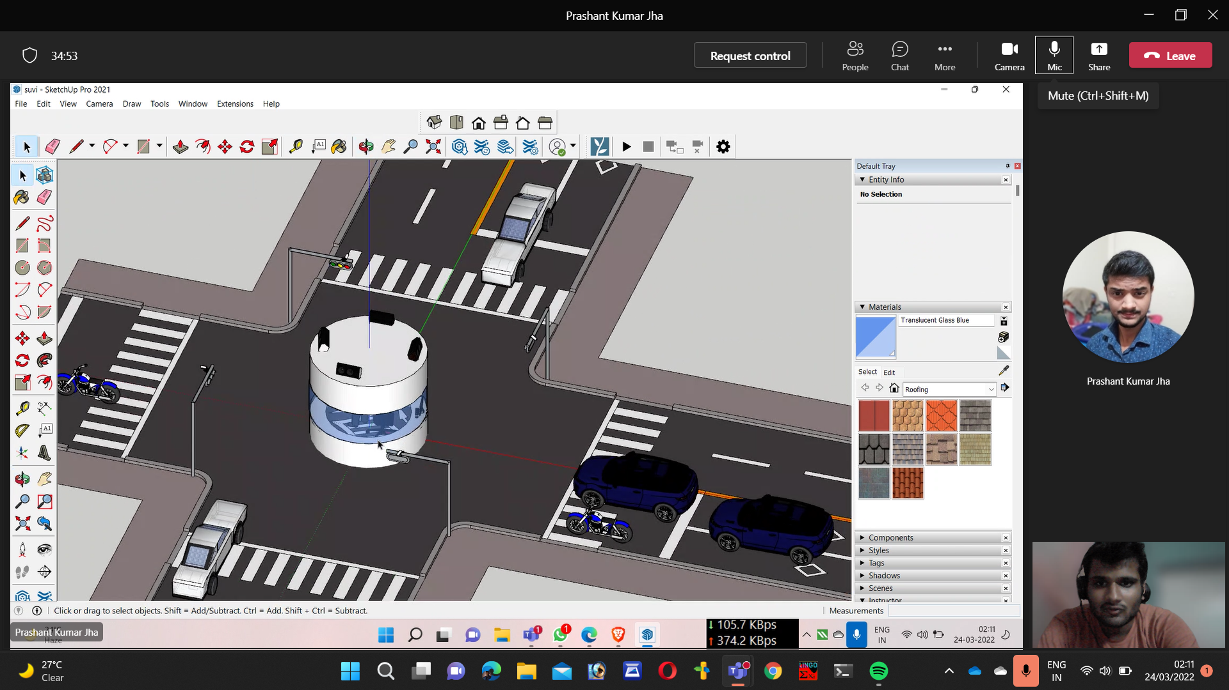
TOP views

Slide 17
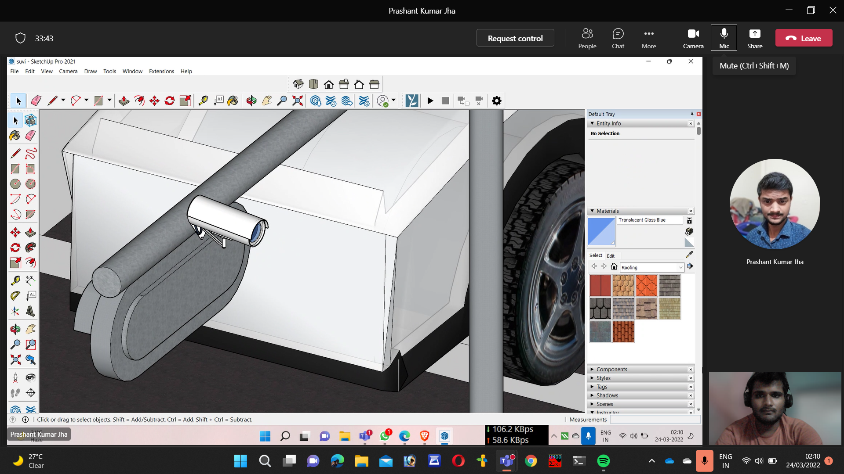
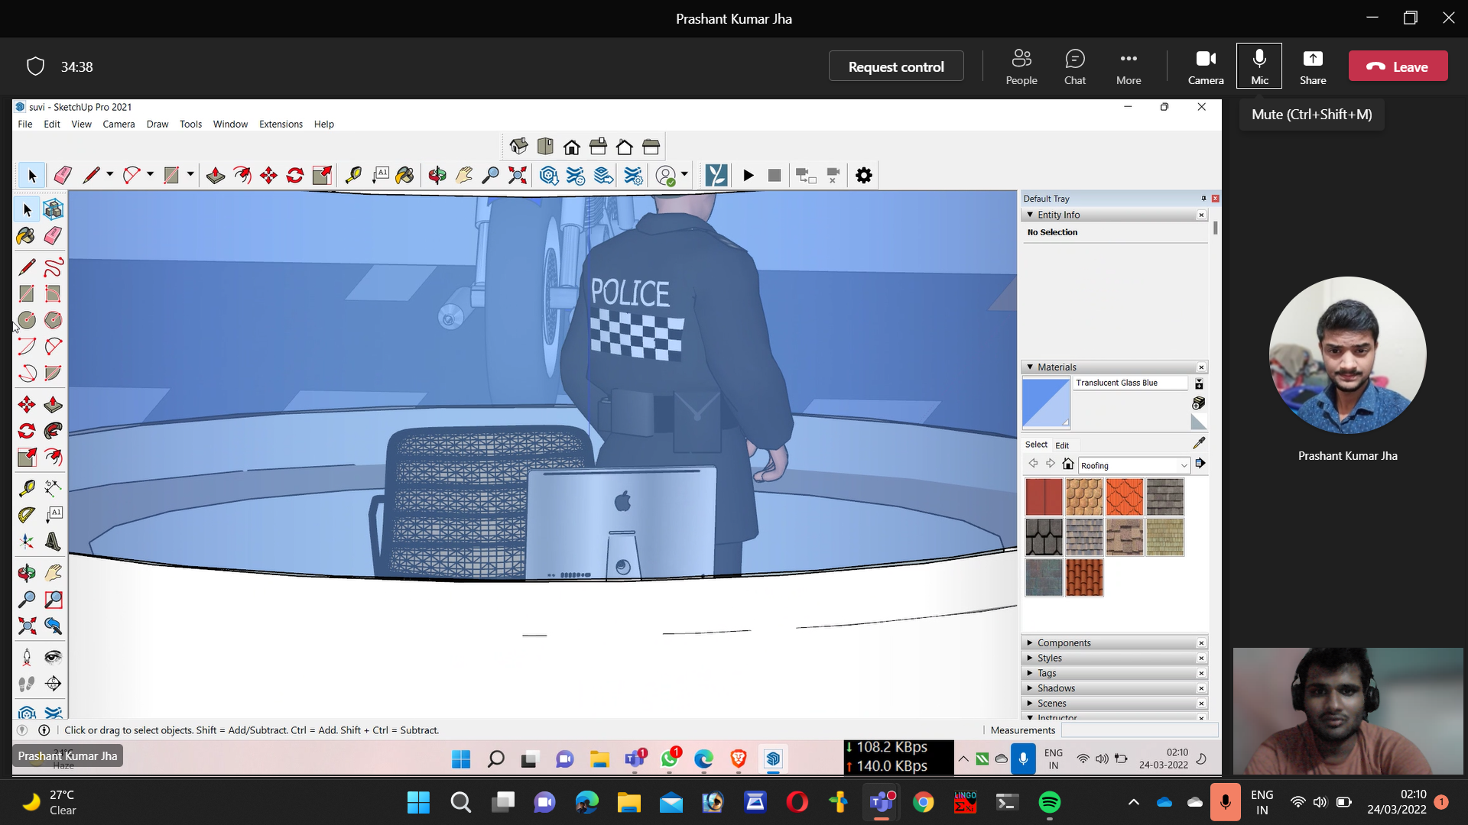
Camera positioning
Inside glimpse

Slide 18
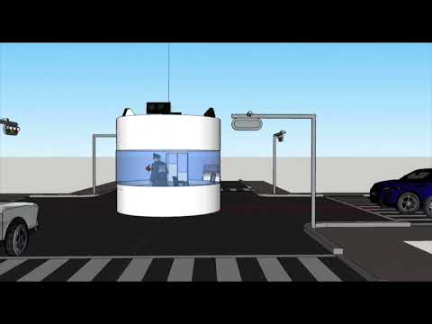

Slide 19
Team-wise work distribution
Solution Model
SUVIGYA, TRISHA, SANSKAR, SNEHA, VEDANT
Control Room Design
SUVIGYA
Automated Challan System
VEDANT , MANIDEEP
Collaboration of Control Rooms
SNEHA, TRISHA
Cost Analysis and Complete Setup
UDIT, SANSKAR, SANIL
Presentation and Explanation
TRISHA, SNEHA, VEDANT, UDIT

Slide 20
Week-wise distribution
Week 1
Problem Selection and Analysis
Week 2
Strategic Solution Modeling
Week 3
Designing of Control Room and it's functioning
Week 4
Integrating Automatic Challan system with Traffic police Control Room
Week 5
Cost analysis
Week 6
Complete integration and final presentation

Slide 21
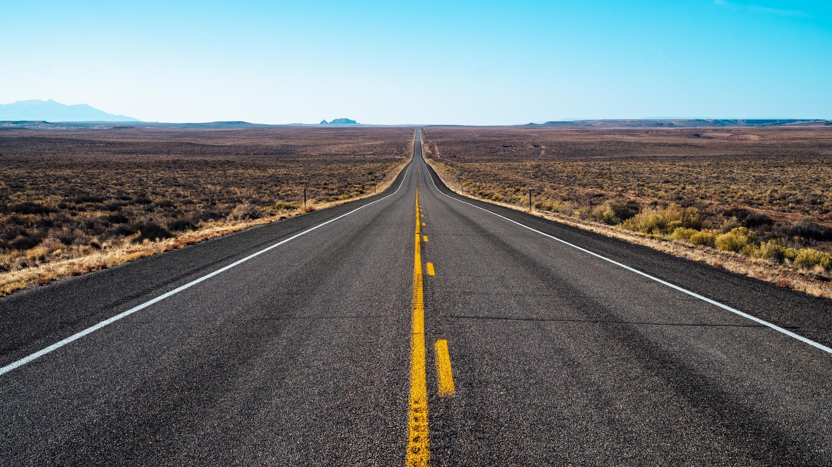


That’s the transition we want to bring!!

Slide 22


